Slide 1


Slide 2
title of project project idea
firstname lastname

Slide 3
Why ? minimize HIV DR

Slide 4

What are we trying to Investigate ? access to medication

Slide 5
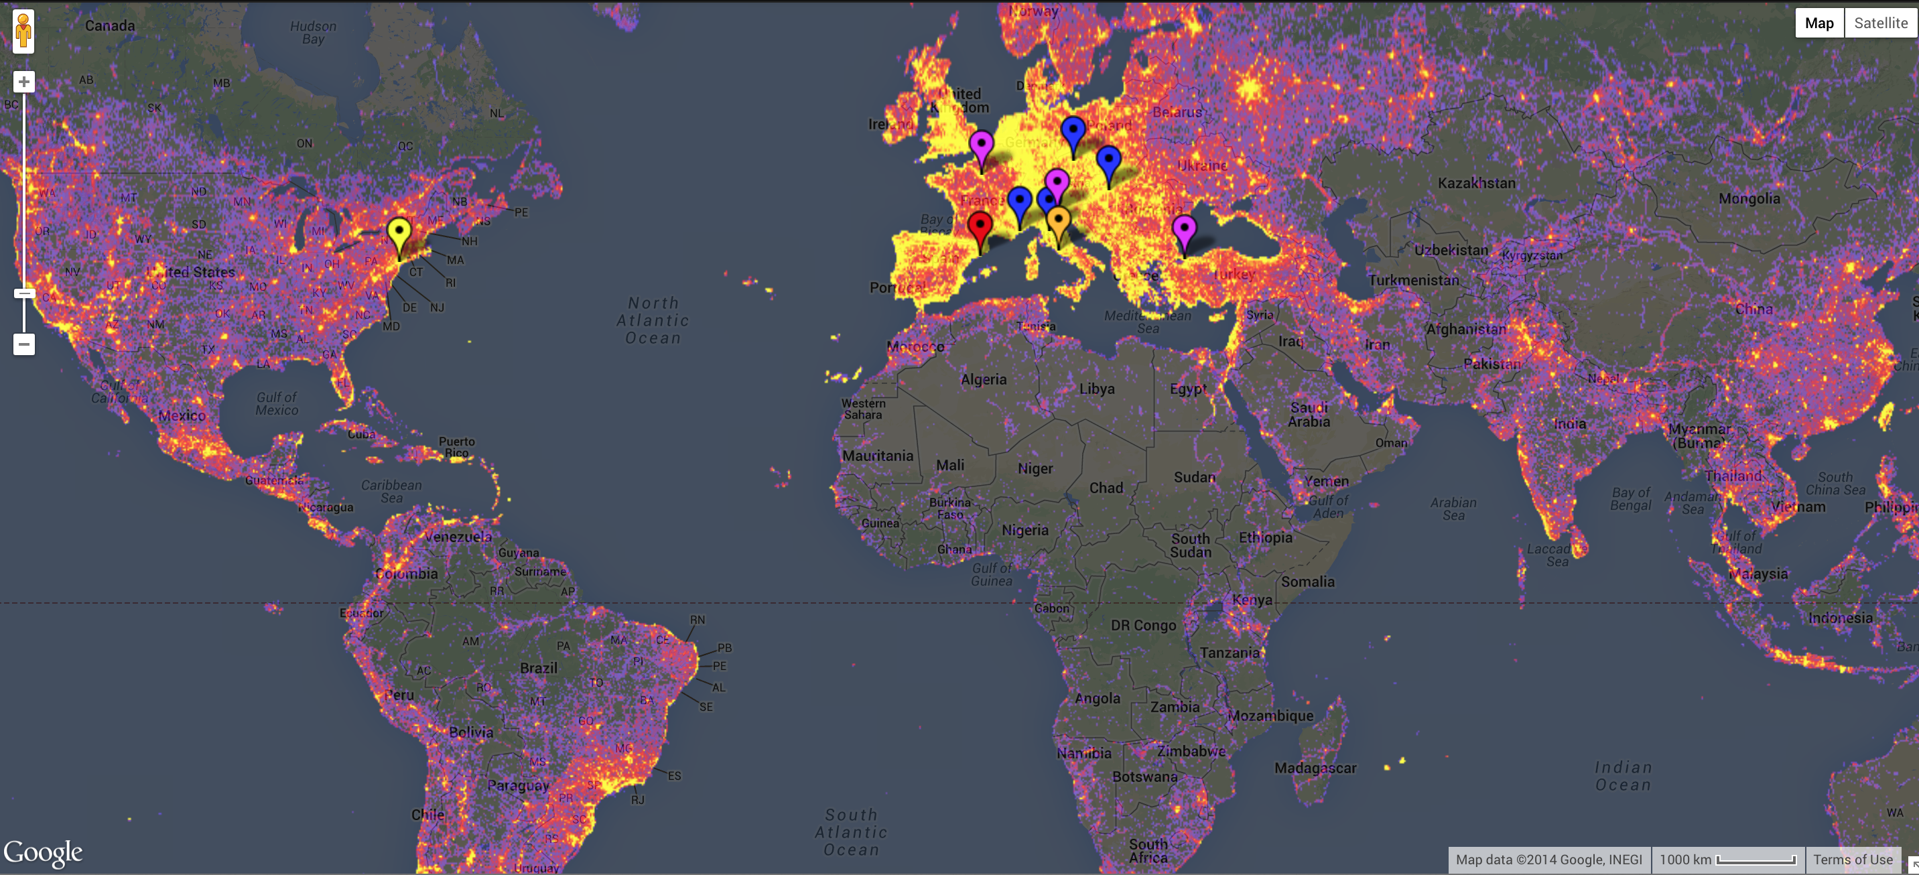
Preferred satisfactory answer ? Predict areas of low access to medication
Find possible causes…

Slide 6
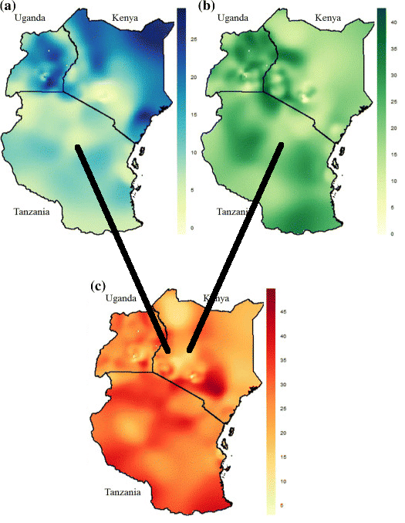
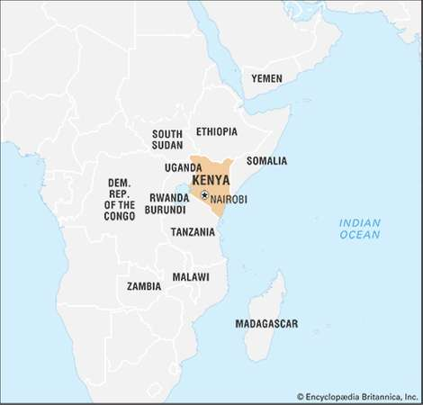
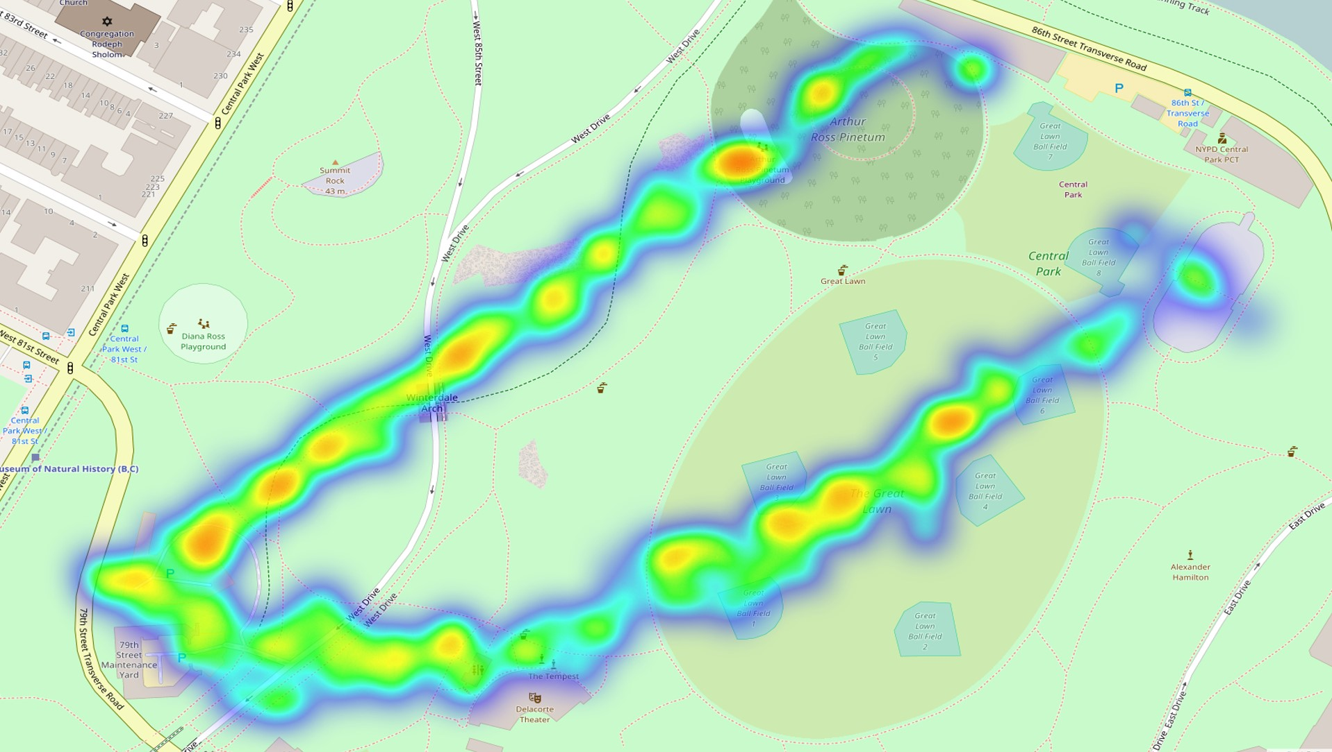
What are the criteria to validate ? Need vs Availability

Slide 7




Which Domain Knowledge is needed ? Logistics, Medical, Social, Economic, Environmental

Slide 8

Domain inspiration ? documentary “Fire in the blood”
Financial barriers + Medicine shortage + Harsh treatment

Slide 9

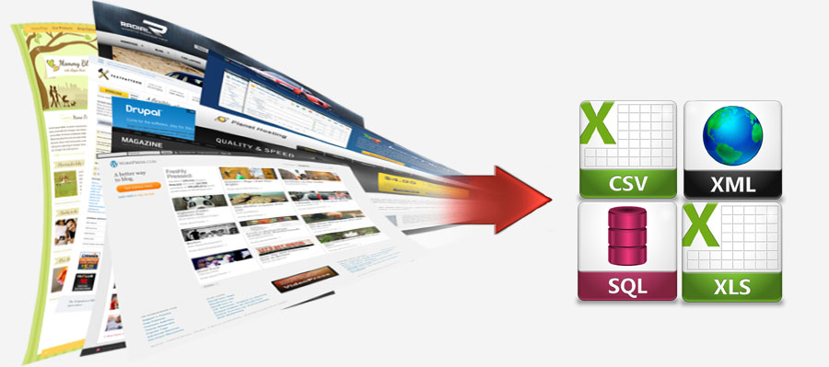

Where to find information sources ? J&J partner, Web sources, Network of people

Slide 10
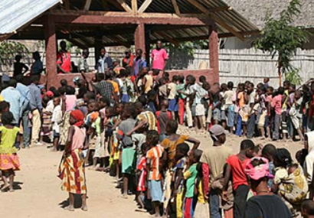


Who can act on our findings ? J&J, NGO, Public
Open method
where a local region
can put in there own data

Slide 11

How to communicate results ? video presentation

Slide 12
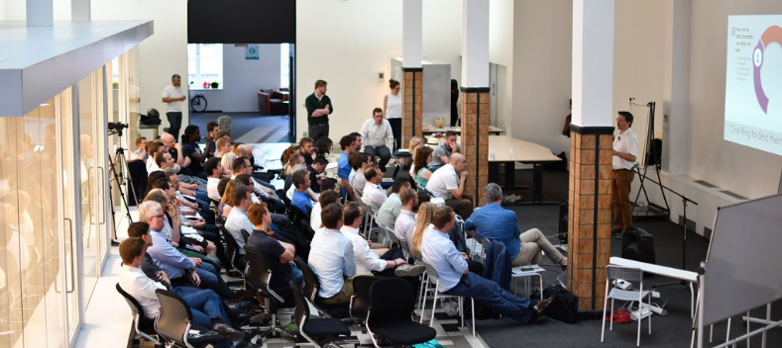
Who is on the Team ? Bootcampers + Public volunteers + …

Slide 13
What skills are needed ?
1
DATA
GATHERING
4
DATA
VISUALIZATION
2
DATA CLEANING
3
DATA MODELING

Slide 14
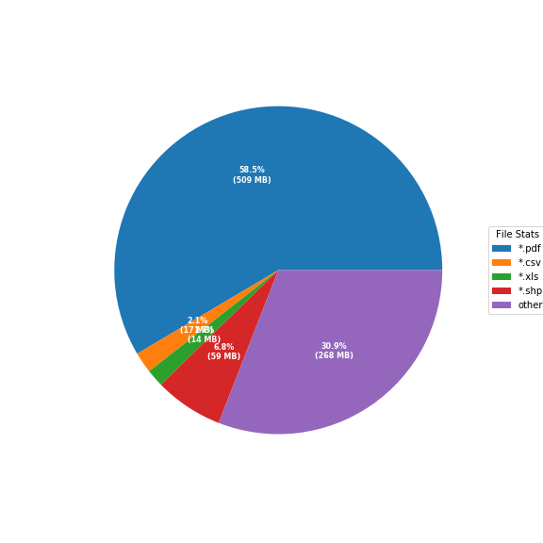
What data resources do we have ? Tanzania (J&J) Kenya (J&J) + unaids.org + blog.opendata.go.ke)
Tanzania

Slide 15
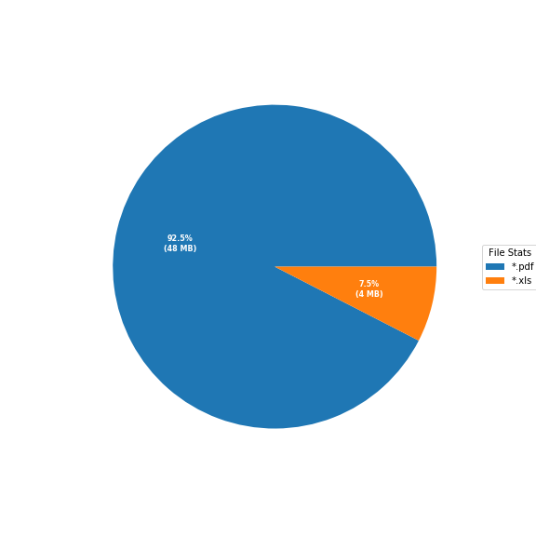
What data resources do we have ? Tanzania (J&J) Kenya (J&J) + unaids.org + blog.opendata.go.ke)
Kenya

Slide 16
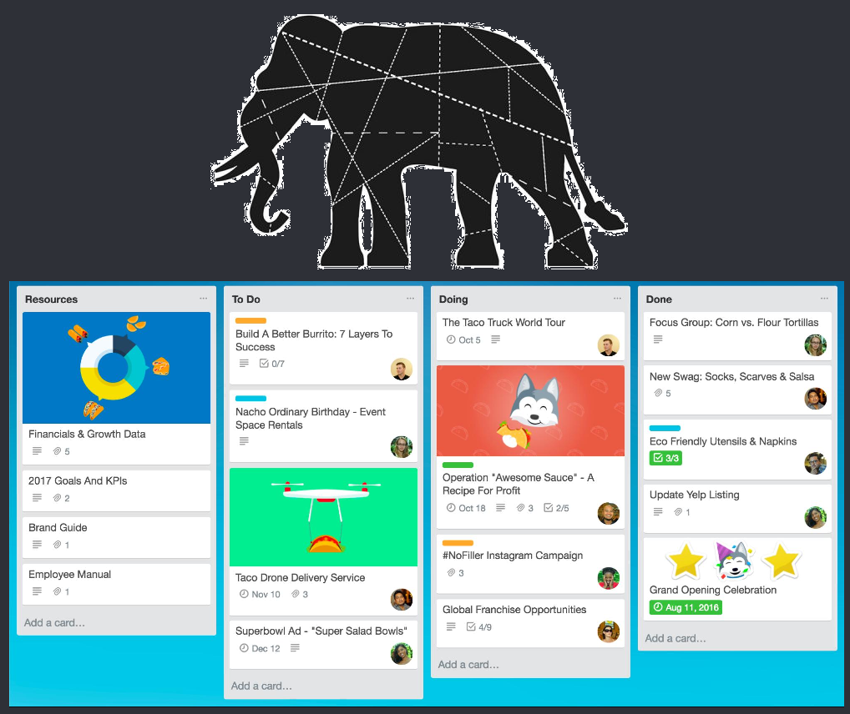
Help ? Small tasks

Slide 17
